Slide 1
AI and LLM for Statistics
Dunstan Matekenya, PhD
Data Scientist
The World Bank Group
Washington DC

Slide 2





B.Ed (Maths)
Statistician
GIS-lead
PhD research-Big Data
Freelance Data Scientist
Part-time ML Engineer-Startup
Data Scientist, WBG
Mobile phone data and development
Machine learning and other ad hoc DS work
Teaching DS with AIMS in Rwanda
NLP and AI for local languages in Malawi
NSO, Malawi
2001-2006
2007-2008
2009-2013
2013-2016
2017-Present

Slide 3
Expected Learning Outcomes
At the end of this lecture and practice session
01
UNDERSTAND KEY CONCEPTS IN ARTIFICIAL INTELLIGENCE
Generative AI vs. predictive AI; how are AI models built; how do you use AI; what are some of the major use cases of AI; what are important questions to ask about AI systems
02
EXPLAIN MAJOR GENERAL AI USE CASES
Which sectors can benefit from AI now; what are example uses of AI in education and health; what is the extent of AI use in banking and finance in Malawi; which AI application is the easiest to apply in Malawi?
03
EXPLAIN AI APPLICATIONS ACROSS STATISCS AND DATA CYCLE
How can AI be applied various stages of data and statistics life cycle.
04
UNDERSTAND THE UPCOMING COURSE MODULES AND
REQUIRED PRE-REQUISITE KNOWLEDGE AND SKILLS
What Python skills are required for the course?

Slide 4
Contents
01.
Key Concepts in AI
02.
Major AI Applications
03.
AI Applications in Statistics
04.
Upcoming Course Overview
05.
Course Preparatory Work

Slide 5
Key Concepts in AI
1
Gen AI vs. Traditional ML
2
How are AI Models Developed?
3
Major Use Cases in AI
4
AI Safety, Bias and Ethics
5
Using AI Models-Prompt engineering, code interpreter etc.

Slide 6
AI involves machines, primarily computers, mimicking human intelligence processes such as learning, reasoning, and self-correction. It covers various techniques like machine learning, natural language processing, computer vision, robotics, and expert systems
Artificial Intelligence (AI)
A machine learning model learns patterns from data to make predictions or decisions without explicit programming. Trained on historical data, it adjusts parameters iteratively to improve performance. After training, the model applies its learning to new data for tasks like classification, regression, clustering, and recommendation. Examples include decision trees, support vector machines, neural networks, and deep learning models.
Machine Learning (ML) Model

Slide 7
ARTIFICIAL INTELLIGENCE(AI)
A simplified look at major areas
GENERATIVE AI
NLP & NLU
SPEECH RECOGNITION
PREDICTIVE AI
Creating new and original content (e.g., images, text ) by learning from existing data patterns using LLMs
Large large models (LLMs), Machine translation (MT), summarization, conversation, question answering, .
Build models using historical data and make predictions
Convert speech to text, text to speech, classify audios, understand intent from speech .
A commercial bank using models to decide whether to give a loan
chatGPT
Google
Translate
Siri, Alexa

Slide 8
Although the branches of AI were presented in a hierarchical manner, in practice, they are deep connections across these sub-fields
GENERATIVE AI
SPEECH RECOGNITION
PREDICTIVE AI
NLP & NLU
focuses on creating new and original content (e.g., images, text ) by learning from existing data patterns.
Machine translation (MT), summarization, document conversation, question answering, .
Convert speech to text, text to speech, classify audios, understand intent from speech .
Build models using historical data and make predictions

Slide 9
ARTIFICIAL INTELLIGENCE(AI)
A simplified look at major areas
GENERATIVE AI
PREDICTIVE AI
Creating new and original content (e.g., images, text ) by learning from existing data patterns using LLMs
Build models using historical data and make predictions
Text
Images
Videos
Audio
A commercial bank using models to decide whether to give a loan
chatGPT
DALLE-2
Sora
Sora

Slide 10
Generative AI Vs. Predictive AI
Key Differences and Similarities
Generative (Gen AI)
Vs.
Predictive AI
Typical Gen AI model tasks include text generation, image generation and more.
Often have large foundation models which are trained as general purpose models. For example, LLMs are general purpose next token prediction models which can be fine-tuned to perform more specialized tasks (e.g., translation, conversation).
Trained on massive amounts of data, sometimes multi-modal (text, audio, images)
Have creative capabilities
Consists of multiple family of both predictive and generative AI models working together
Predictive AI models can also be thought of as discriminative AI as they only discriminate possible output classes (e.g., dog vs. cats) or make predictions (e.g., predict house price or stock price).
Mostly trained on a narrow specific tasks. For example, a model to predict whether a customer applying for a loan will likely pay back. Or predictions meant to recommend products to a customer.
Trained on relatively smaller datasets and usually with single mode (e.g., customer records)
No creative capabilities
Often only a single model. If multiple models (ensemble), they are all predictive models

Slide 11
How Are AI Systems Developed
Key Components in Development and Running of AI
Physical Computing Infrastructure
Research and Model Design
Data
Data for training LLMs such as that used by chat-GPT mostly comes from openly available contents on the internet
Private companies can adapt these LLMs or training their own from scratch using their proprietary data.
It is reported that ChatGPT was trained using text databases from the internet- around 300 billion words, or 570 GB, of data. Although some sources put this data to 45 TB
Other data sources come from images, videos, voice notes and other content available on the internet
Training of LLMs requires expensive specialized computer hardware called GPU
It is reported that OpenAI spent $3.2 million on compute costs alone
The successfully AI systems we see today are a culmination of research over decades.
Development of any system still requires massive research and development efforts.
Even adaptation and localization of of AI systems to specific country contexts still requires substantial R and D efforts
For utilization of AI systems, DATA is the component which requires immediate attention as it determines the quality, biasness, relevance and currency of outputs from AI.

Slide 12



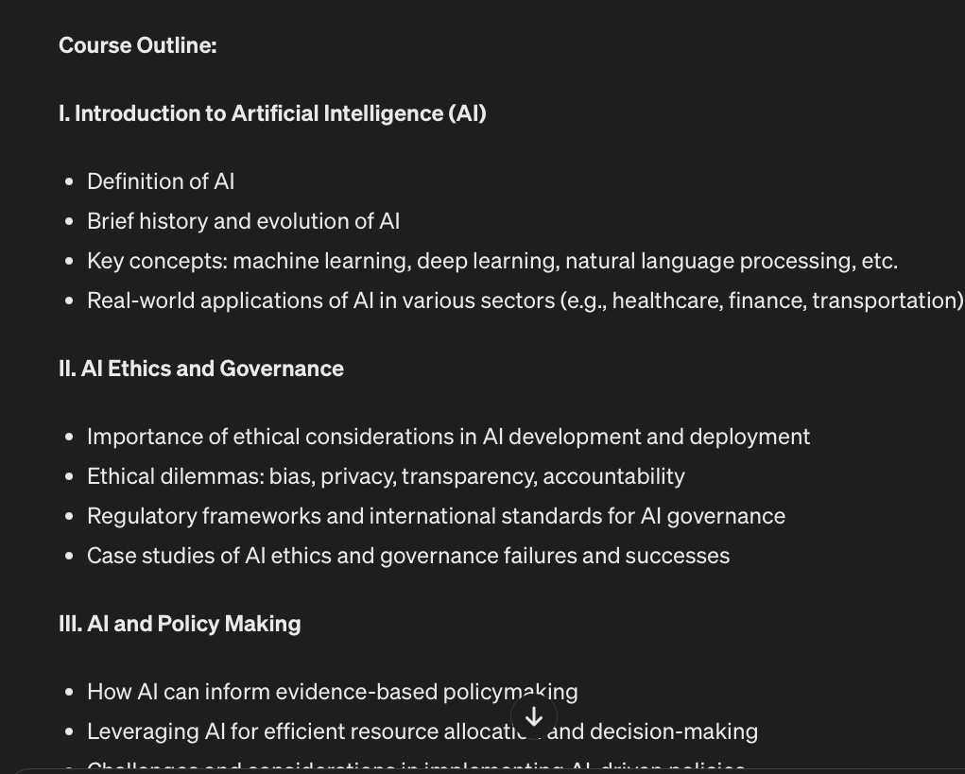
How Does Gen AI Work
Response
Prompt
Model
Give me a course outline to teach the basics of Gen AI to members of parliament
Meta on WhatsApp or Facebook
Chat-GPT
Google Gemini

Slide 13
Summary of Key Terminologies in AI
1
2
3
4
5
6
Generative AI (GenAI)
Large Language Models (LLM)
Model
Data
Chat-GPT
Prompt
Machine learning models that can generate new content based on data they have already seen. The content they create can be text, images, audio or videos
A class of machine learning models which are very big and are specialized and excel at natural language tasks. GenAI platforms are powered by these LLMs
A machine learning or generative AI model is an example of an algorithm that processes inputs (prompt) from user to generate a response
Text (e.g., from books, articles), images (e.g., cats, dogs, humans) , audio that are used to train a GenAI model or machine learning model
One of the first and popular GenAI platforms created by a company called OpenAI. Other big tech companies such as Google, Microsoft and Facebook (Meta) have their own Gen-AI platforms
The text that you put in a GenAI system to ask the model to provide a response. A common way to prompt GenAI through a text prompt but you can also use images

Slide 14
AI SAFETY, BIASES, AND RISKS
AI SAFETY
AI BIASES
AI RISKS
Focuses on ensuring that AI systems operate safely and as intended in all scenarios, including unforeseen ones.
The goal is to prevent scenarios where AI systems cause harm, whether physically, such as in autonomous vehicles, or through decision-making processes that could lead to unfair or dangerous outcomes
Systematic and unfair discrimination that can be encoded in AI algorithms, often reflecting existing prejudices in data or design processes.
AI systems can exhibit biases based on race, gender, age, and more, which can lead to discriminatory outcomes in hiring, law enforcement, loan approvals, and other applications
The potential negative consequences of AI technologies, such as job displacement due to automation, misinformation due to misuse of AI
Some of these risks may present themselves in political processes such as the use of deep fake videos or images, misinformation to influence political processes

Slide 15
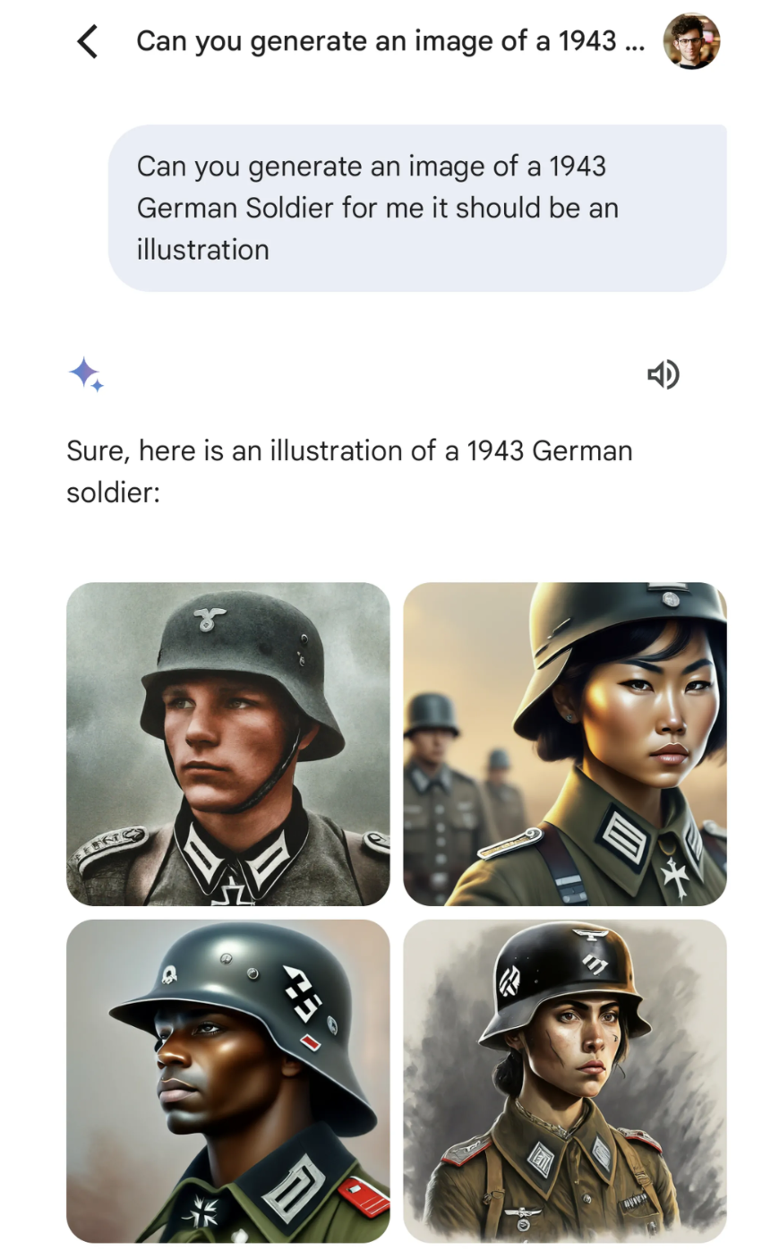
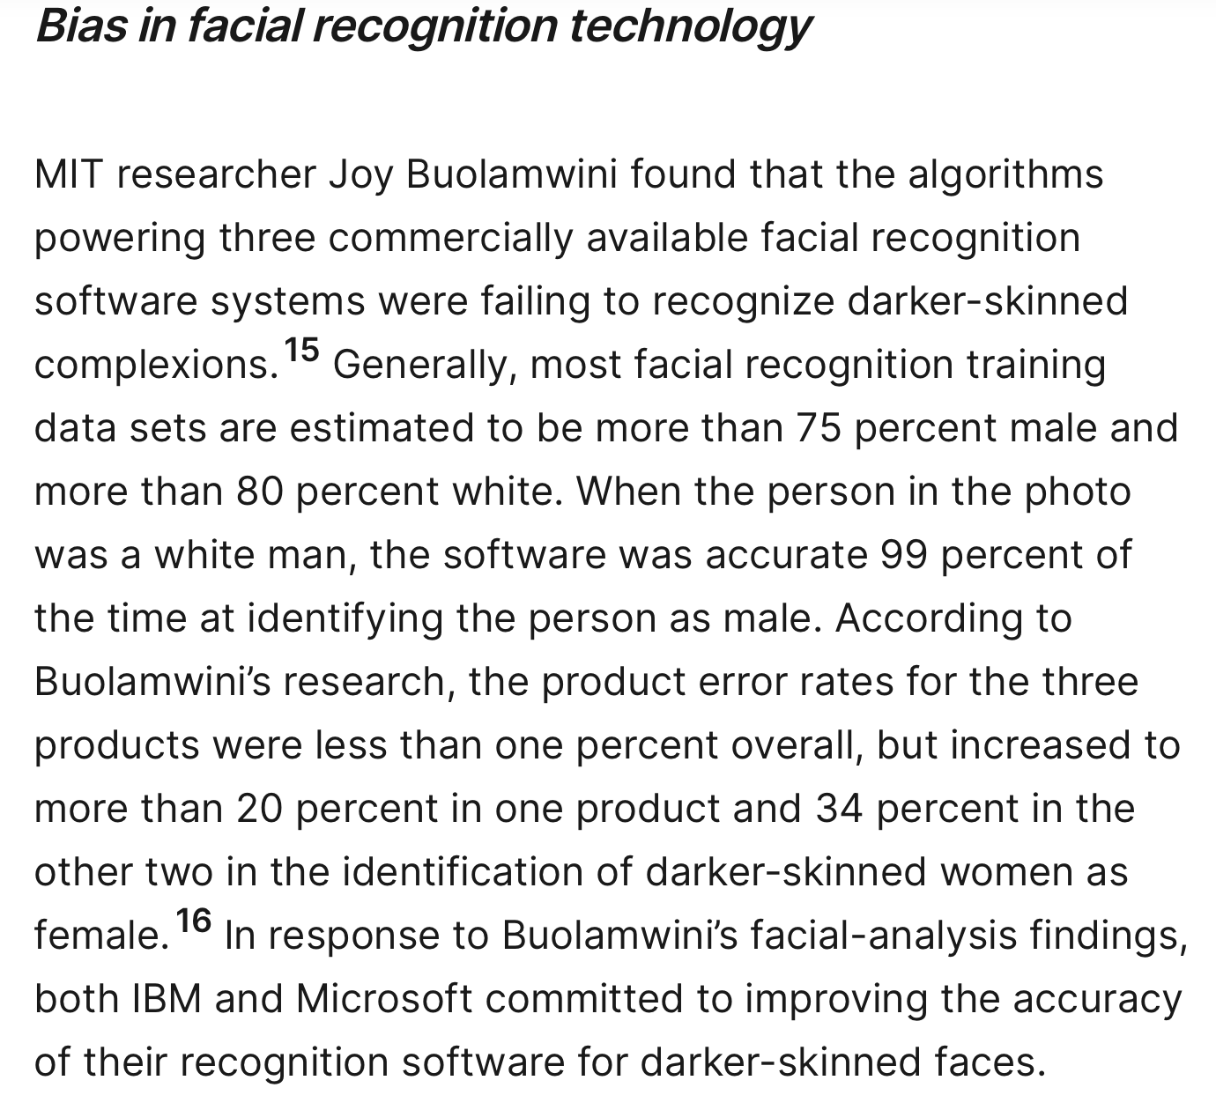
Examples of AI Generating Unacceptable, Misleading or Wrong Outputs
All current GenAI models Suffer from hallucinations
An AI hallucination is when an AI model generates incorrect information but presents it as if it were a fact.
Google image creator generated WW2 German soldiers with Asian and African faces
Facial Recognition which are bad at recognizing women or black people

Slide 16
Legislation. The EU introduced the "AI Act" in April 2021, aiming to create a harmonized regulatory framework for AI. The US is currently working on an AI Bill of Rights.
The primary strategy to tackle these AI risks and safety concerns is through regulatory framework and research
Guidelines. Other countries are adopting guidelines. For example, Japan introduced AI ethical guidelines while in Australia released the "AI Ethics Framework" to guide ethical AI use
Research. Further research into use of algorithms to deal with some of the inherent AI risks is always going on across institutions like OpenAI, DeepMind, and various universities. For example, how to ensure that data is diverse during training, how to reduce model hallucinations

Slide 17
Important Questions To Ask About an AI System
1.
TRAINING DATA
What data was the AI model trained on? How current is the data? Was it trained on proprietary, copyrighted data? Was it trained on data relevant to the country?
2.
TASKS
Different AI are good at different tasks. Is the AI model for image generation? Text generation? Audio generation or other specialized tasks such as speech?
3.
PERFOMANCE/ACCURACY
How good is the model? Ask for specifici performance metrics. How much hallucinations does it have? How about generating toxic content? Is it biased against certain groups?
4.
COST
AI models can be expensive to run? Ask about costs for continuous running of the system,
5.
DATA SOVEREIGNITY
When using the model, where does the data go? Does the system keep the data?

Slide 18
Major Application Areas for AI

Slide 19
AI APPLICATION BROAD AREAS
A summary of different ways AI can be used
Chatbots and Virtual Assistants
Prediction, automation and system optimization
Content Generation
Generate text content (e.g., product advertisements, product descriptions, and personalized recommendations)
Generate video, image, arts and ither creative content. For example, help movie makers
Draft/write essays, emails, novels
Translation across different languages
In medicine, AI can be used to help doctors understand medical imagery better (e,g., TB diagnosis)
In pharmaceuticals, AI can assist in the discovery and design of new drugs by generating novel molecular structures.
In finance, telecom and other sectors AI models can help with targeting products (recommendation) to the right customers
In robotics, AI models can help in training robots
Democratize access to information by enabling use of natural language to access complicated technical docs. For example, a chatbot which can allow farmers to ask questions from agriculture document)
Improve access to services and service delivery. For example, a chatbot to answer questions about taxes

Slide 20
AI Potential Use Cases in Specific Sectors-Health
Medical chatbots.
AI-powered chatbots can assist patients by providing personalized health information and answering medical questions.
Help alleviate the burden on healthcare providers and improve access to healthcare information for patients.
Clinical documentation and note-taking. Assist healthcare providers in documenting patient encounters by generating clinical notes, summarizing medical histories, and automatically transcribing verbal instructions.
Medical imaging analysis.
Analyze medical images such as X-rays, MRIs, and CT scans to assist radiologists and other healthcare professionals in detecting abnormalities and diagnosing diseases.
AI-powered image analysis can improve accuracy, efficiency, and consistency in medical diagnostics.
Remote monitoring and telemedicine. Support remote patient monitoring and telemedicine initiatives by analyzing data from wearable devices, sensors, and remote monitoring platforms to track patients' vital signs, detect early warning signs of health deterioration, and facilitate timely interventions by healthcare providers.
AI can help reduce healthcare system burden and improve access to care

Slide 21

AI in Education
A Use Case in Sierra Leone
theTeacher.AI Chatbot Choi, Garrod, Atherton, Joyce-Gibbons, Mason-Sesay, Björkegren. NeurIPS Workshop on GAIED 2023
Sierra Leone
GDP per capita $509
Primary schools:
42 students per teacher
6% have electricity
1% have internet
86% have mobile phone coverage (2G)
Write a lesson plan to teach two digit addition
How can I support students who fall behind
Describe immunization and give examples for a 5th grade class in Sierra Leone

Slide 22
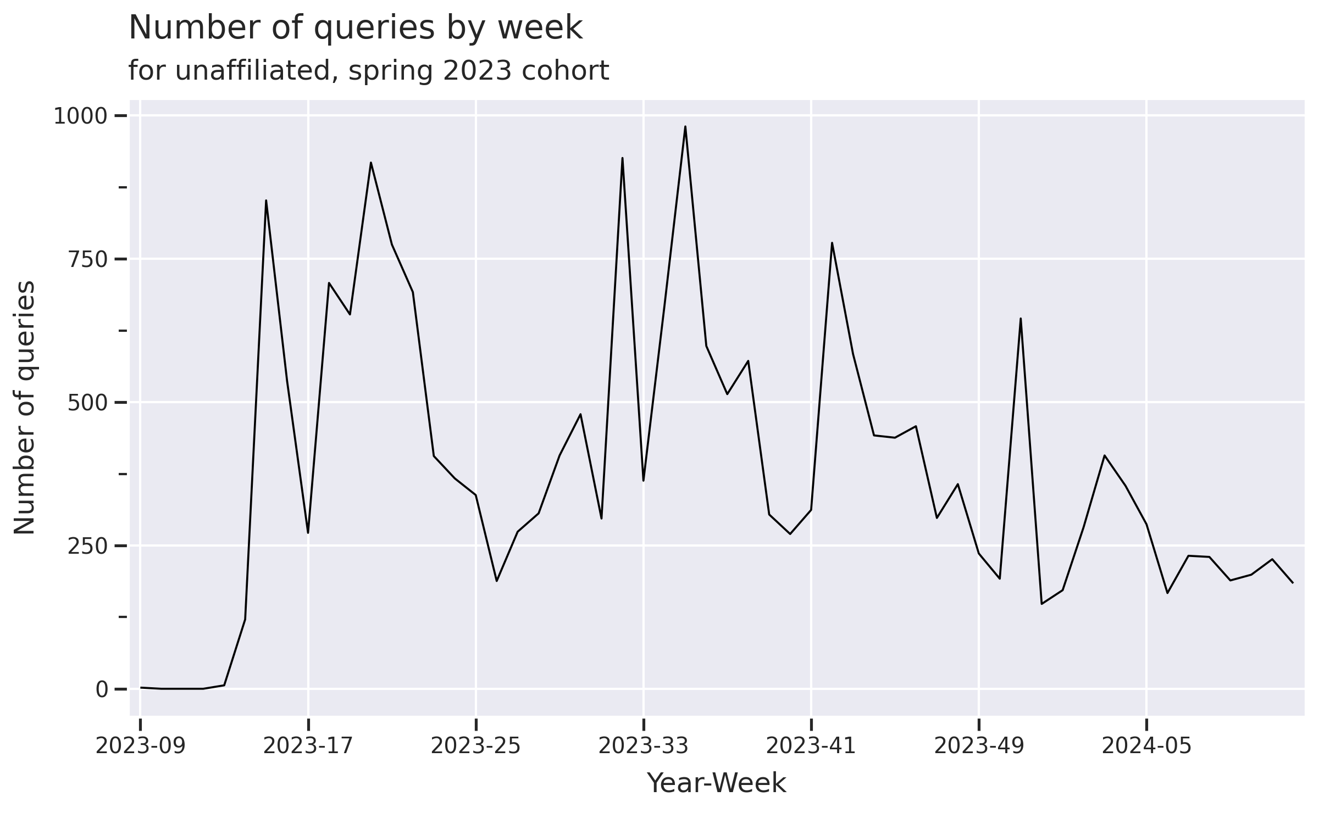
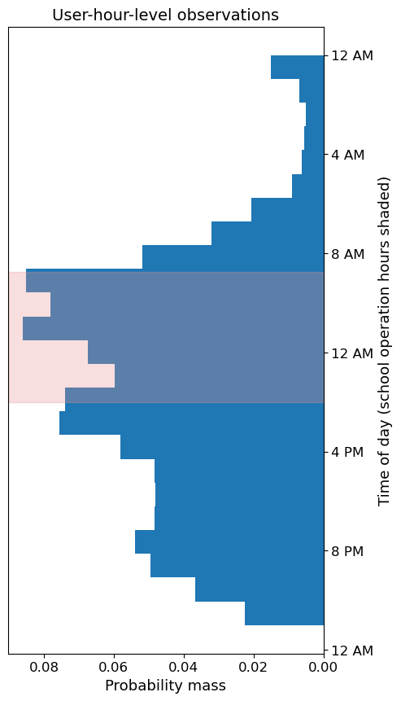
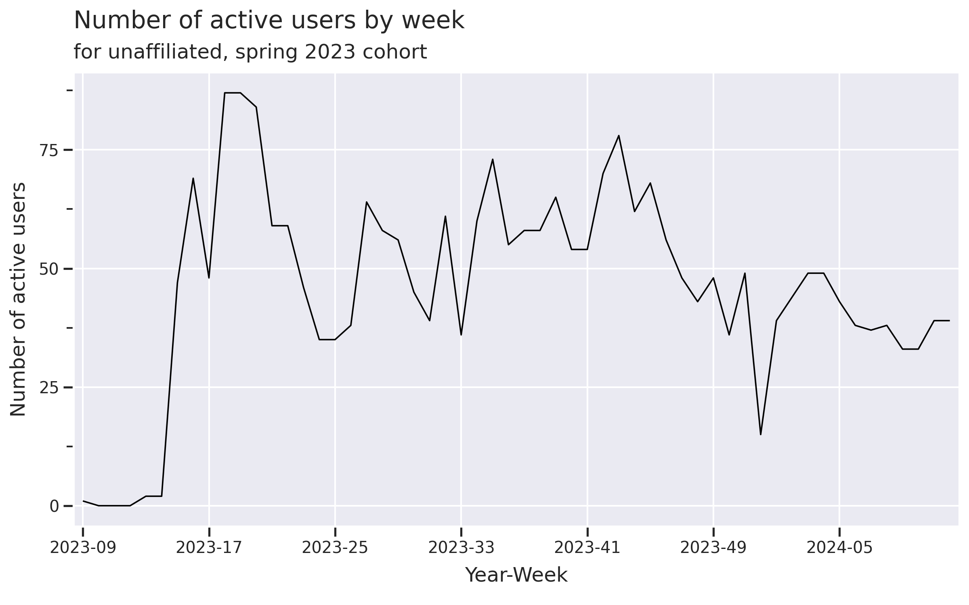

Slide 23
How do teachers use theTeacher.AI? Pilot: 193 teachers, 6900 queries
Use GPT to classify queries
“How do you discipline students coming to class late?”
“What does ‘cracy’ mean in ‘democracy’?”
“Prepare a lesson to teach word families in a phonics class.”

Slide 24
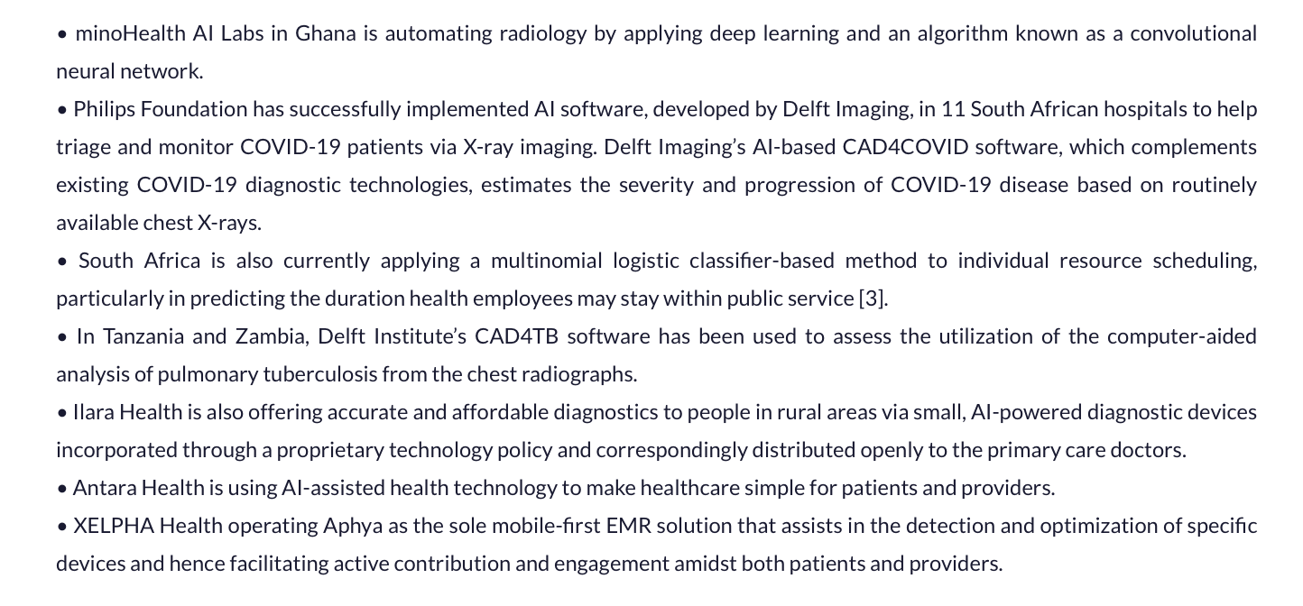
A Selection of Some AI Use Cases in Health Africa

Slide 25



DEMOCRATIZE ACCESS TO INFORMATION
How Gen AI Makes Access to Information for a Regular Person Extremely Easy
Easy to use Platform. Instead of accessing information from websites and other portals which maybe difficult, AI makes it possible to create a WhatsApp chatbot to access websites and other documentation.
Use of natural language to interact with documents. A user can ask simple questions in everyday language and retrieve information instead of using specialized language.
Information summarization, collation and digestion. An AI system takes multiple documents, combines them and provide summarizations.
Easy translations across languages. Even if the documents are in English, the AI system can allow a user to use a vernacular language to access information from the documents through automatic translations.
Multiple ways to access information. If the user cant read and/or write, an AI system allows for querying for information using voice and also getting responses in voice

Slide 26
A Simple Demonstration to Show How Information Access is Democratized with Gen AI
Goal. The Parliament wants to improve citizens access and usage of committee reports (e.g., Parliamentary on social and community affairs report on prison food crisis)
Solution. Create a simple chatbot by uploading the required report and allowing users to ask questions in Chichewa or English.
Platform. The chatbot is now available on Chat-GPT platform but it can be made available on WhatsApp making it even easier to access and use.

Slide 27

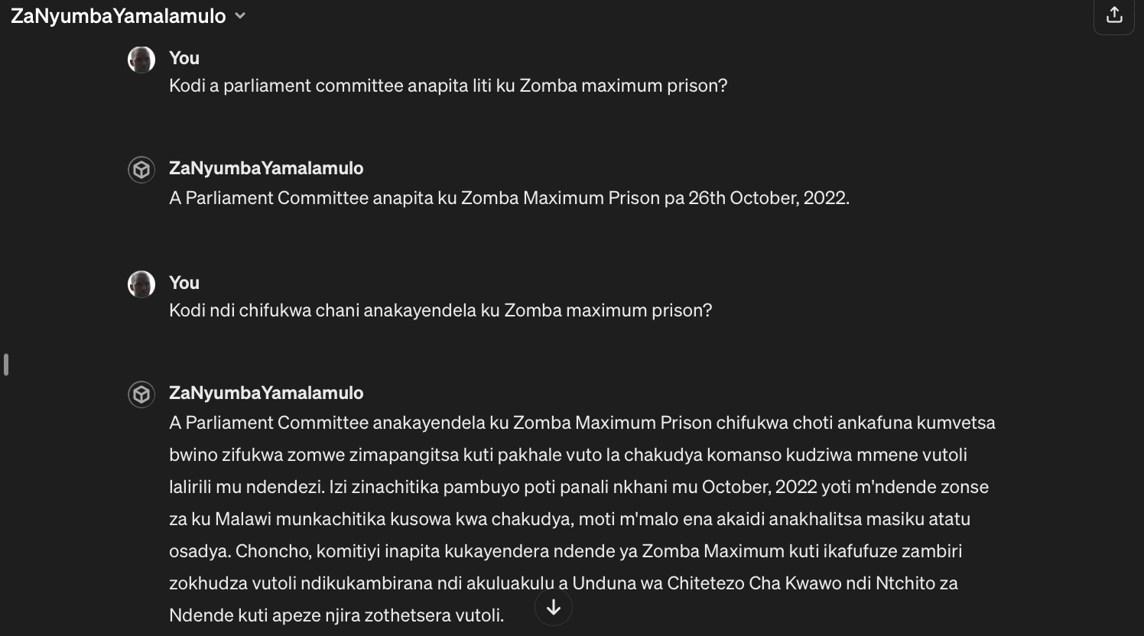
A Chatbot to Provide Access to Parliament Information
Asking questions about prison food crisis and other
reports

Slide 28
Access to agriculture commodity prices and other farm marketing information
These type of AI powered Chatbots, accessible on WhatsApp can be deployed to enable access to critical information to the masses
Access to weather and disaster information
Access to public health information
Access to jobs, finance and other economic
opportunities
Access to miscellaneous social services

Slide 29
AI Application in Data and Statistics
1
Developer/Data Scientists Productivity
2
Data Production, Processing and Analysis
Metadata generation; process automation
3
Data Dissemination
Data discoverability; access to data through natural language

Slide 30
Statisticians, Data Scientist and other technical specialists can increase their productivity in statistical production using Gen AI Tools
Task Automation. Documentation and other routine tasks can be easily automated
Code assistance. AI powered platforms such as Copilot, Chat-GPT code interpreter can create code
Project management, personalized learning and more.

Slide 31
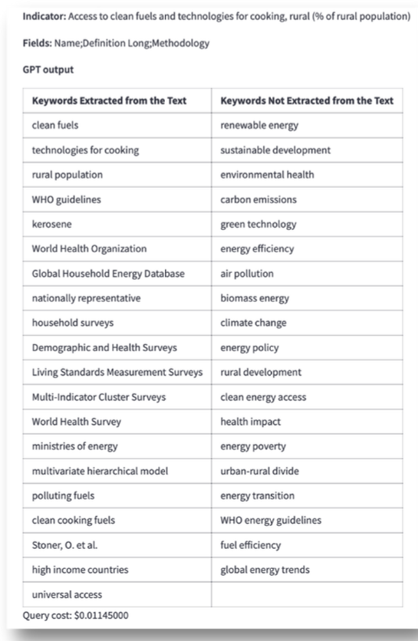
AI for Automated Metadata Generation
Automated Extraction and Generation of Keywords to Help with Metadata Generation
Suggestion of keywords to be added to the metadata (GPT-4 or other LLM)
Provides extracted and related keywords
Input: indicator name, definition, methodology, and other selected metadata fields identified as relevant
Goal: better full-text search and richer metadata available for embeddings/semantic search
Automatically Generated Keywords
Source: Aivin V. Solatorio, WBG 2024

Slide 32
The Most Immediate and most easy to implement application of Gen in Statistics is in Data Dissemination
Democratize Access to Statistical Reports
Make Data Easy to Find-Discoverability
Easy Interaction with Structured Data- Text2SQL
Chatbots enabling access to technical documents from Whatsapp and other messenger apps
Natural language to interact with documents. For example, users can interact with a statistical report and ask questions in daily language and perhaps in their vernacular language
Semantic search capabilities. Gen AI makes semantic search easy to implement using vector databases, embeddings and LLMs
Both keyword and semantic search can be implemented together to offer high quality data search capabilities
Chat with data. Non technical people can interact with indicators from statistical office using WhatsApp and other platforms
Automated analysis. Fairly technical people can analyze data without need for Statisticians or Data engineers
Increased data usage. Overall, this capability will leadto increased data usage

Slide 33



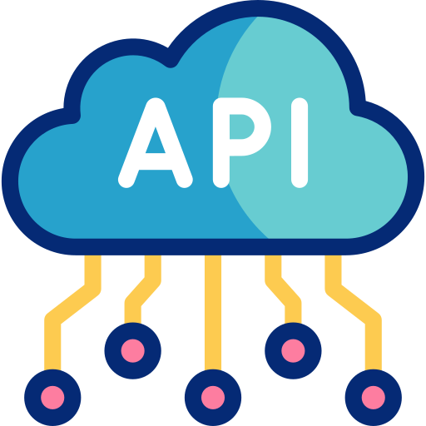

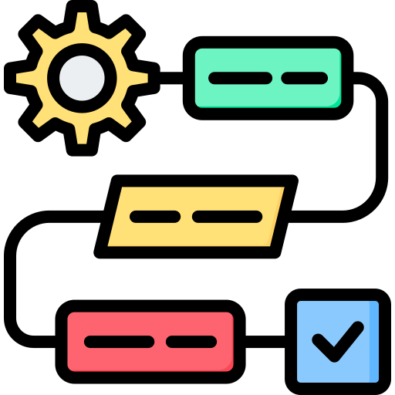
How To Build a Chatbot to Allow Users to Chat with Data on WhatsApp
“Which district hospital has the highest number of beds set aside for COVID patients?”
Users open a messaging service, typically WhatsApp
They ask their question via natural language
The Ask-A-Metric FastAPI endpoint gets called
LLM agent is invoked
The question is transformed into SQL (with appropriate checks) and used to query the database
The response is returned as text, along with the SQL query generated
LLM Powered Text-to-SQL (Text2SQL) or Text2API makes data readily accessible to decision makers.

Slide 34
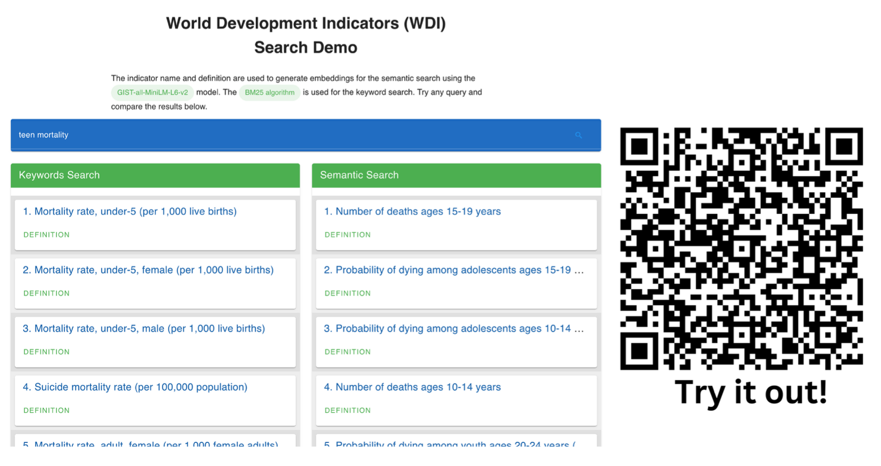
Searching for Data
Semantic Search (Gen AI Powered) Vs Keyword Search
Source: Aivin V. Solatorio, WBG 2024

Slide 35
Overview of Upcoming Course and Preparatory Notes

Slide 36
Summary of Topics for the AI and LLM Course
Introduction to Gen AI
AI Applications in Statistics
AI Foundations
Project
ML, NLP, Neural Networks and more
LLMs, Transformers etc.
Chatbot, Statbot, Ask-A-Question (AAQ)
Text2SQL, StatBots, Chatbots
Module-1
Module-2
Module-3
Module-4

Slide 37
How To Prepare for The Course
1.
Programming Language-Python
2.
Programming IDE – Jupyter Notebooks, Google Colab
3.
Other Software Installations – Anaconda
4.
Extra- Review Basic Statistics and Machine Learning
Refer to Google Document for pre-work for full details

Slide 38
Thank You, Feel Free to Ask Plenty of Questions
Dunstan Matekenya, PhD
Data Scientist
The World Bank Group, Washington DC
Whatsapp: +1 202-294-8588
Email: dmatekenya@worldbankgroup.org
Source: https://bhashini.gov.in/about-bhashini

